Slide 1



Operational research for urban solar development
“PV failure detection based on operational time series”
26/11/2024
Alexandre Mathieu

Slide 2
Curriculum
Day | Time | Duration | Content
Wednesday 13/11/2024 | 11h15-12h45 14h15-15h45 | 1h30 + 1h30 | 50% Lecture / 50 % Hands-on
Tuesday 26/11/2024 | 9h45-13h00 | 1h30 + 1h30 | 25% Lecture / 75 % Hands-on
Monday 02/12/2024 | 13h15-16h15 | 3h | 15% Lecture / 85 % Hands-on
Monday 09/12/2024 | 8h-11h 13h15-16h15 | 6h | 10% Lecture / 90 % Hands-on/Project
Tuesday 10/12/2024 | 8h-11h | 3h | 10% Lecture / 90 % Project
Monday 16/12/2024 | 8-11h | 3h | 10% Lecture / 90 % Project
Thursday 19/12/2024 | 9h45-12h45 | 3h | 10% Lecture / 90 % Project
Monday 06/01/2025 | 13h15-14h45 | 1h30 | 100% Project
Monday 13/01/2025 | 9h45-11h45 | 1h30 | 100% Project
Total |  | 27h
Plan

Slide 3
Agenda
Review notebook last week
PV performance model steps
Notebook: Shading effect on irradiance

Slide 4
Review first notebook
Notebook recap 13/11/2024
Google collab link: https://github.com/AlexandreHugoMathieu/pvfault_detection_solar_academy/blob/master/notebooks/python_intro_poa.ipynb
Correction: https://github.com/AlexandreHugoMathieu/pvfault_detection_solar_academy/blob/master/notebooks/python_intro_poa.ipynb

Slide 5
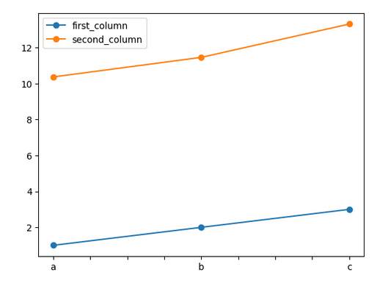
Review first notebook
ts
a | 1
b | 2
c | 3
import numpy as np # import to your python instance the package “numpy” and rename it “np” (helpful for math calculations)
import pandas as pd # import to your python instance the package “pandas” (helpful for data structure and calculations)
ts = pd.Series([1, 2,3], index=['a','b','c']) # Initiate a pandas serie into variable “ts”
ts2 = ts + ts/2 + np.cos(ts) + np.pi # Make calculate with “ts” and store it into “ts2”
print(ts2) # print serie ts
ts.plot(marker="o") # Make a plot of ts with “o” (circle) marker
df = pd.DataFrame() # Initiate an empty dataframe into variable “df”
df["first_column"] = ts # Store “ts” serie in a column labeled “first_column”
df["second_column"] = ts2 * 2 # Store “ts2” serie in another column labeled “second_column”
df.plot(marker="o") # Make a plot of df with “o” (circle) marker
df.loc[“a”, :] # Select the entire row with “a” as index
df.loc[“a”, “first_column”] # Select the value with “a” as index and “first_column” as column
index
values
df
first_column
second_column
Notebook recap 13/11/2024
Python commands 1/4
a | 1 | 2
b | 2 | 4
c | 3 | 6
index

Slide 6
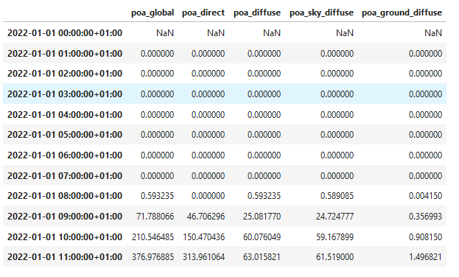
Review first notebook
####### Calculate POA, the lazy way #######
from pvlib.irradiance import get_total_irradiance # import the function “get_total_irradiance from pvlib”
# On another note, pvlib* is a very useful package for PV modeling with plenty of convenient functions, do not hesitate to look it up on the web
beta = 20 # tilt [°]
azimuth = 180 # azimuth [°]
rho = 0.2 # albedo
solar_position = pd.read_csv("solarpos_data.csv") # Import the data file "solarpos_data.csv“ which contains the sun path (azimuth and elevation) with datetime index
weather_data = pd.read_csv("sat_data.csv", index_col=0) # Import the data file “sat_data.csv“ which irradiance (dni, ghi, dhi) with datetime index
data = get_total_irradiance(beta, azimuth, solar_position["zenith"], solar_position["azimuth"], weather_data["dni"], weather_data["ghi"], weather_data["dhi"], albedo=rho) # Directly apply the isotropic models
print(data.head(12)) # Show the first 12 lines of the DataFrame
values
Notebook recap 13/11/2024
Python commands 2/4
Pvlib ref *William F. Holmgren, Clifford W. Hansen, and Mark A. Mikofski. “pvlib python: a python package for modeling solar energy systems.” Journal of Open Source Software, 3(29), 884, (2018). https://doi.org/10.21105/joss.00884

Slide 7
Review first notebook
####### Function definition #######
# Function, useful to store few lines of code you want to reuse and apply with different inputs
def my_func_name(argument1, argument2):
# Define the function “my_func_name" with the "def" command and a small increment tab to the right
y = argument1 + argument2 * 2
return y
my_func_name(1,2) # Apply the function with the two mandatory arguments and return 5
my_func_name(1,argument2=3) # Return 7
my_func_name(argument2=3, argument1=2) # Return 8
Notebook recap 13/11/2024
Python commands 3/4

Slide 8
Review first notebook
####### Function definition #######
# Function, useful to store few lines of code you want to reuse and apply with different inputs
def my_func_name2(argument1, argument2, argument3=0):
# Define the function “my_func_name" with the "def" command and a small increment tab to the right
# Argument3 is optional
y = argument1 + argument2 * 2 + argument3
return y
my_func_name2(1,2,2) # Apply the function with three arguments and return 7
my_func_name2(1,2) # Apply the function with the two mandatory arguments and return 5
my_func_name(argument2=3, argument1=2, 3)
# Crash because all arguments need to be specified on the right of a keyword argument
-> “”” SyntaxError: positional argument follows keyword argument”””
Notebook recap 13/11/2024
Python commands 4/4

Slide 9
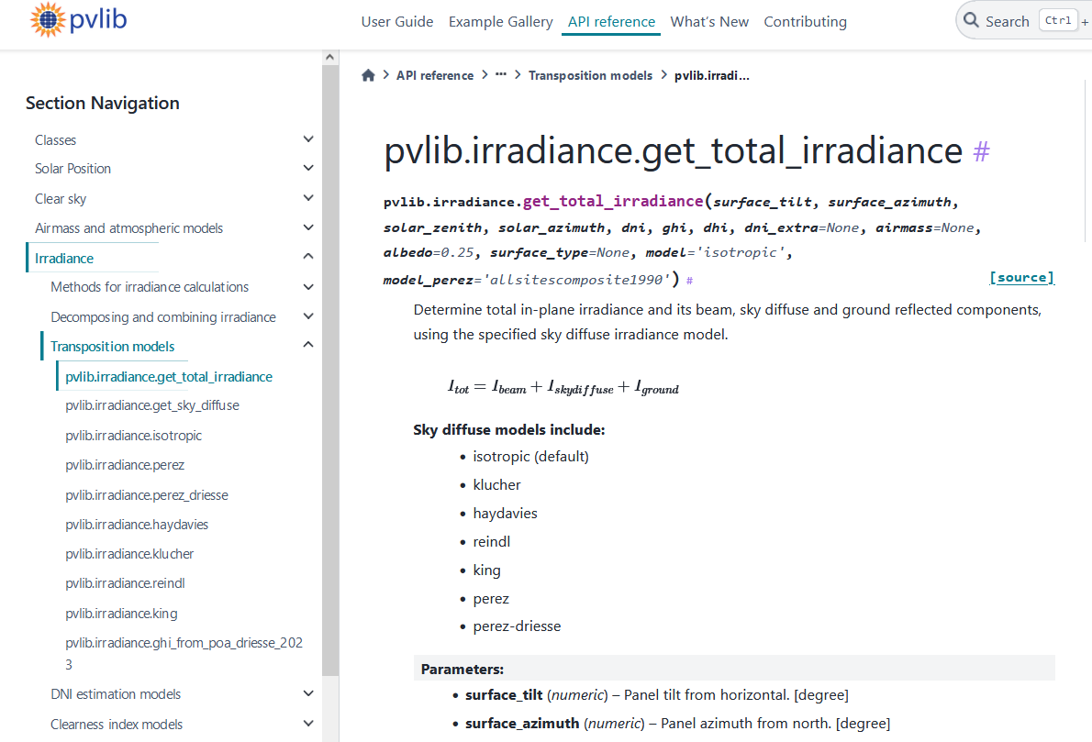
Review first notebook
https://pvlib-python.readthedocs.io/en/stable/reference/generated/pvlib.irradiance.get_total_irradiance.html
Online
Documentation

Slide 10
Review first notebook
https://pvlib-python.readthedocs.io/en/stable/reference/generated/pvlib.irradiance.get_total_irradiance.html
Online
Documentation
Mandatory arguments

Slide 11
Review first notebook
https://pvlib-python.readthedocs.io/en/stable/reference/generated/pvlib.irradiance.get_total_irradiance.html
Online
Documentation
Mandatory arguments
Optional (default) arguments

Slide 12
Agenda
Review notebook last week
PV performance model steps

Slide 13
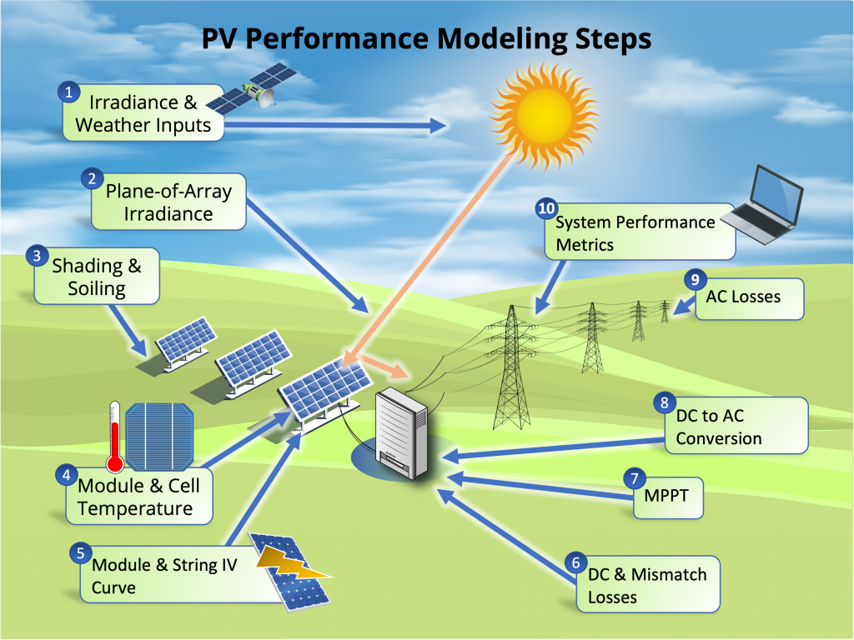
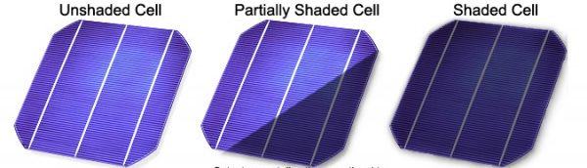
Modeling steps
3. Shading
Shadow can come from near and far elements and their impact can be distinguished into two categories
Partial shading refers to a condition where some but not all of the solar cells or panels in a PV array are exposed to sunlight while others are shaded.
Full shading occurs when the entire PV array is covered and deprived of direct sunlight.
*https://mcisolutions.ca/effect-of-shade-on-solar-panels/

Slide 14
Modeling steps
3. Shading
Shadow can come from near and far elements and their impact can be distinguished into two categories
Partial shading refers to a condition where some but not all of the solar cells or panels in a PV array are exposed to sunlight while others are shaded.
Full shading occurs when the entire PV array is covered and deprived of direct sunlight.
In average, if a PV panel is around 8% covered, bypass diodes start to activate and **might** reduce the module power production to much lower levels.
Demonstrated in one of pvlib example: https://pvlib-python.readthedocs.io/en/stable/gallery/shading/plot_partial_module_shading_simple.html
*https://mcisolutions.ca/effect-of-shade-on-solar-panels/

Slide 15
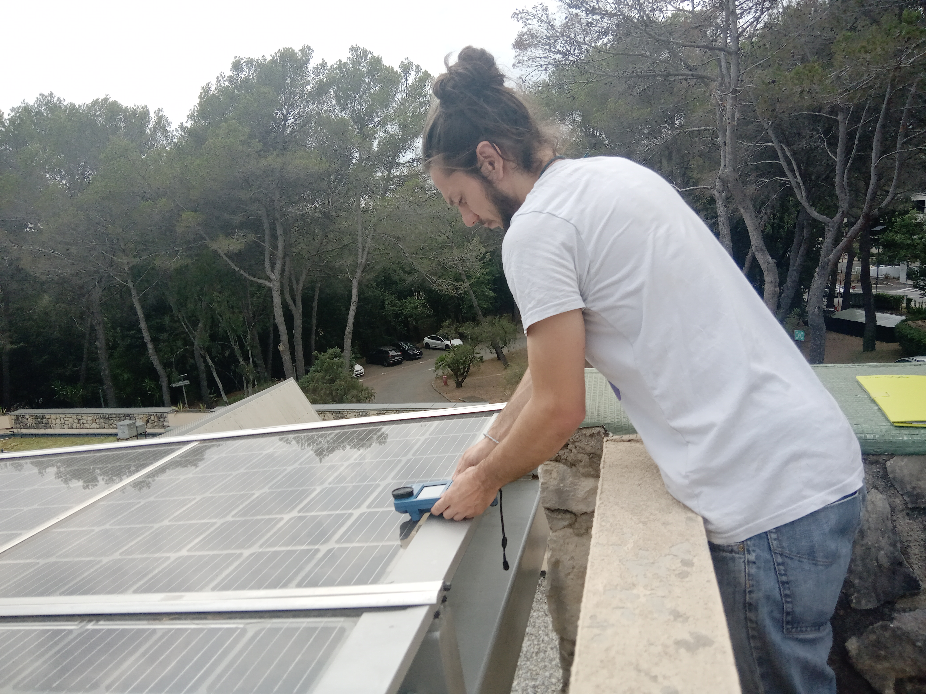
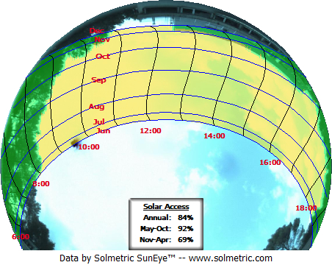
Modeling steps
Fisheye camera
3. Shading
The Fisheye camera enables to account for the in-situ (full) shading in PV modeling.
South
East
West
North
Example in South of France

Slide 16
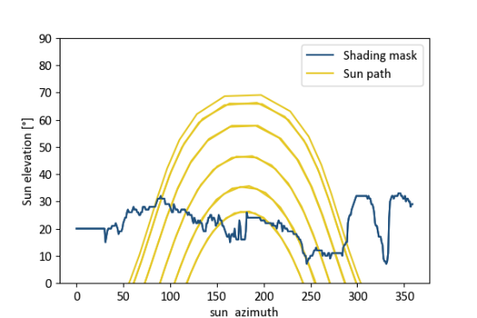
Modeling steps
Fisheye camera
3. Shading
The Fisheye camera enables to account for the in-situ (full) shading in PV modeling.
South
East
West
North
Example in South of France

Slide 17
Modeling steps
South
East
West
North
Example in South of France

Slide 18
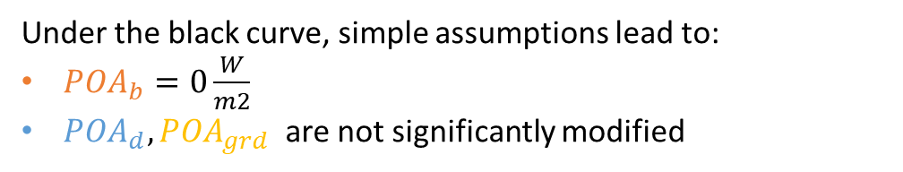
Modeling steps
3. Shading
The Fisheye camera enables to account for the in-situ (full) shading in PV modeling.
Under the black curve, simple assumptions lead to:
$POA_{b}=0\frac{W}{m2}$
$POA_{d}, POA_{grd}$ are not significantly modified
South
East
West
North
Example in South of France

Slide 19
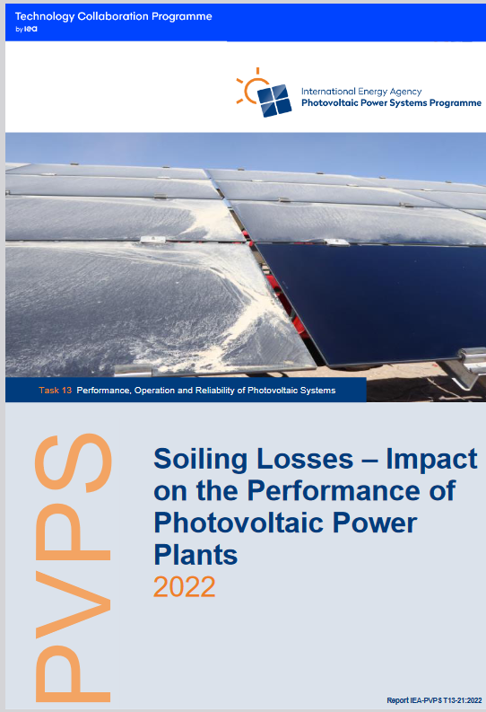
Modeling steps
3. Soiling losses
Big subject in the PV industry:
“Soiling losses refer to loss in power resulting from snow, dirt, dust and other particles that cover the surface of the PV module.” (Maghami et al., 2016)
Report of 130 pages on PV soiling: IEA PVPS, Soiling Losses – Impact on the Performance of Photovoltaic Power Plants 2022

Slide 20
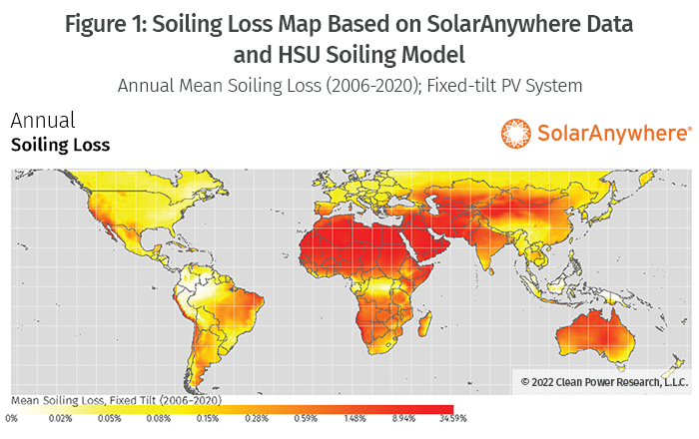
Modeling steps
3. Soiling losses
Can roughly be ignored in France according to the HSU model.
Model HSU: M. Coello and L. Boyle, "Simple Model for Predicting Time Series Soiling of Photovoltaic Panels, Sept. 2019.

Slide 21

Modeling steps
3. Shading / Terrain horizon mask
Time for some hands-on exercises,
Again!

Slide 22
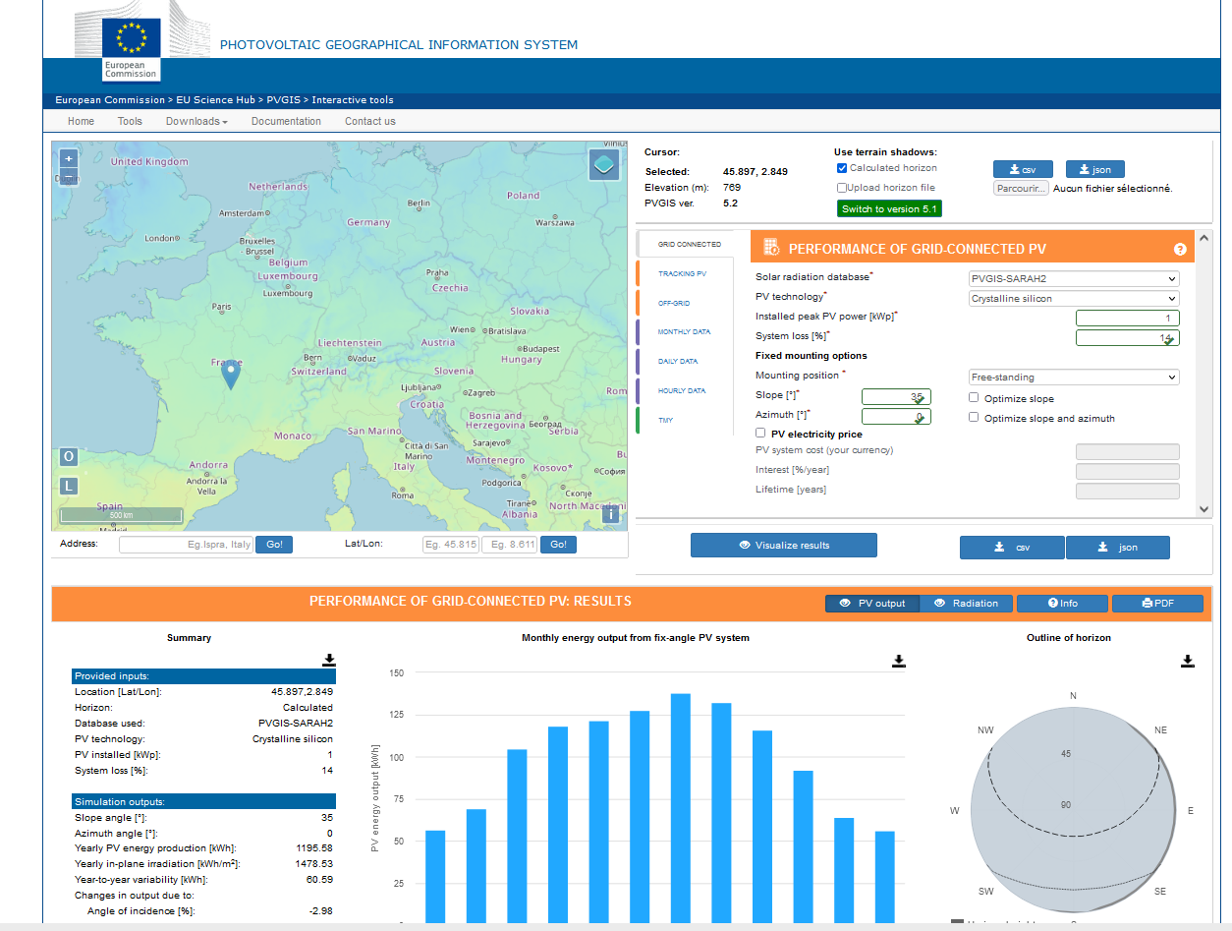
Modeling steps
3. Shading / Terrain horizon mask
PVGIS: Website/Online Tool to estimate power production: https://re.jrc.ec.europa.eu/pvg_tools/en/
Enables to extract the horizon mask with a Digital Surface Model (DSM).
Instructions:
Generate a simulation on PVGIS
Click on the map on Grenoble and select the « Grid connected tab »
Vizualize
Extract the horizon file in csv format
2. Follow the instructions on the jupyter notebook and calculate the modified POA on one year. https://colab.research.google.com/drive/1hB1pmBw-n7RiS99vCHQi2OKicfcQxpcO?usp=sharing
Notes:
Show function
Create function to get the API horizon mask
How many hours is the direct component blocked ?

Slide 23
Resources
Modeling guide PVPMC: https://pvpmc.sandia.gov/modeling-guide/
Python / Pvlib tutorial: https://pvsc-python-tutorials.github.io/PVSC48-Python-Tutorial/
To go further:
The Use of Advanced Algorithms in PV Failure Monitoring: https://iea-pvps.org/wp-content/uploads/2021/10/Final-Report-IEA-PVPS-T13-19_2021_PV-Failure-Monitoring.pdf
Shading
PV education 7.2, widget: https://www.pveducation.org/pvcdrom/modules-and-arrays/shading
How to take into account shading from LIDAR data: Solar Energy Potential Assessment on Rooftops and Facades in Large Built Environments Based on LiDAR Data, Image Processing, and Cloud Computing. Methodological Background, Application, and Validation in Geneva (Solar Cadaster), Desthieux et al. https://www.frontiersin.org/journals/built-environment/articles/10.3389/fbuil.2018.00014/full

Slide 24
That’s it

